Slide 1
Transcription and Translation
Chapter 14
p. 263-273

Slide 2
Protein Structure
Made up of amino acids
Polypeptide- string of amino acids
20 amino acids are arranged in different orders to make a variety of proteins
Assembled on a ribosome

Slide 3
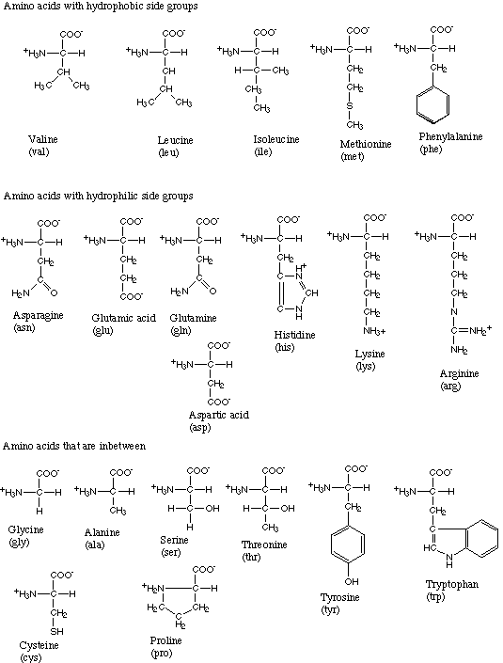

Slide 4
Questions to be answered today
How do we get from the bases found in DNA to amino acids?
How do we get from a bunch of amino acids to proteins?

Slide 5
Replication
DNA double helix unwinds
DNA now single-stranded
New DNA strand forms using complementary base pairing (A-T, C-G)
Used to prepare DNA for cell division
Whole genome copied/replicated

Slide 6
Transcription and Translation: An Overview (aka the Central Dogma)
Transcription
Translation

Slide 7
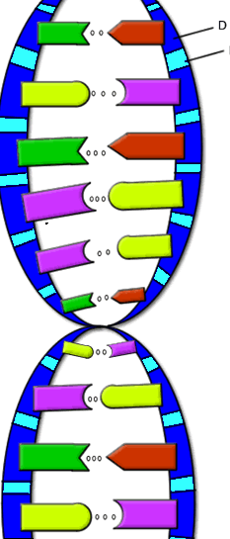
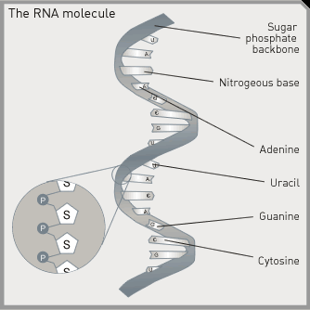
RNA vs. DNA
DNA
Double stranded
Deoxyribose sugar
Bases: C,G A,T
RNA
Single stranded
Ribose sugar
Bases: C,G,A,U
Both contain a sugar, phosphate, and base.

Slide 8
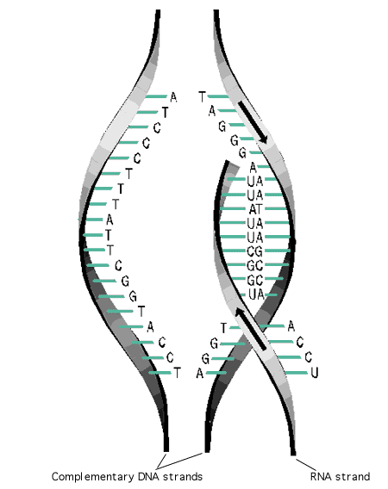
Transcription
RNA forms base pairs with DNA
C-G
A-U
Primary transcript- length of RNA that results from the process of transcription

Slide 9
TRANSCRIPTION
ACGATACCCTGACGAGCGTTAGCTATCG
UGC
UAU
GGG
ACU

Slide 10
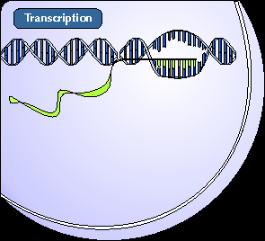
Major players in transcription
mRNA- type of RNA that encodes information for the synthesis of proteins and carries it to a ribosome from the nucleus

Slide 11
Major players in transcription
RNA polymerase- complex of enzymes with 2 functions:
Unwind DNA sequence
Produce primary transcript by stringing together the chain of RNA nucleotides

Slide 12
mRNA Processing
Primary transcript is not mature mRNA
DNA sequence has coding regions (exons) and non-coding regions (introns)
Introns must be removed before primary transcript is mRNA and can leave nucleus

Slide 13
Transcription is done…what now?
Now we have mature mRNA transcribed from the cell’s DNA. It is leaving the nucleus through a nuclear pore. Once in the cytoplasm, it finds a ribosome so that translation can begin.
We know how mRNA is made, but how do we “read” the code?

Slide 14
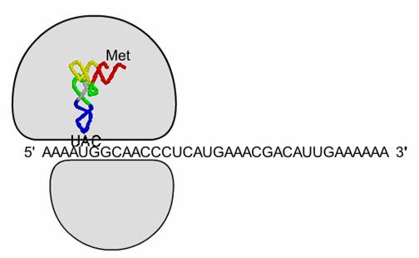
Translation
Second stage of protein production
mRNA is on a ribosome

Slide 15
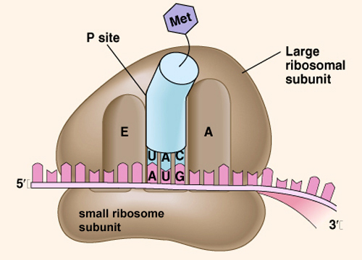
Ribosomes
2 subunits, separate in cytoplasm until they join to begin translation
Large
Small
Contain 3 binding sites
E
P
A

Slide 16
Translation
Second stage of protein production
mRNA is on a ribosome
tRNA brings amino acids to the ribosome

Slide 17
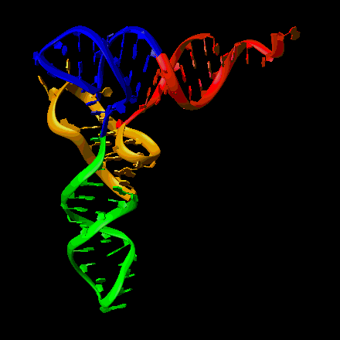
tRNA
Transfer RNA
Bound to one amino acid on one end
Anticodon on the other end complements mRNA codon

Slide 18
tRNA Function
Amino acids must be in the correct order for the protein to function correctly
tRNA lines up amino acids using mRNA code

Slide 19
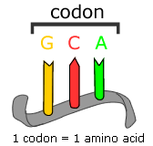
Reading the DNA code
Every 3 DNA bases pairs with 3 mRNA bases
Every group of 3 mRNA bases encodes a single amino acid
Codon- coding triplet of mRNA bases

Slide 20
How many bases code for each amino acid?
1 base = 1 amino acid
4¹ =
2 bases = 1 amino acid
4² =
3 bases = 1 amino acid
4³ =

Slide 21
The Genetic Code

Slide 22
ACGATACCCTGACGAGCGTTAGCTATCG
UGC
UAU
GGG
ACUG

Slide 23
Which codons code for which amino acids?
Genetic code- inventory of linkages between nucleotide triplets and the amino acids they code for
A gene is a segment of RNA that brings about transcription of a segment of RNA

Slide 24
Transcription vs. Translation Review
Transcription
Process by which genetic information encoded in DNA is copied onto messenger RNA
Occurs in the nucleus
DNA mRNA
Translation
Process by which information encoded in mRNA is used to assemble a protein at a ribosome
Occurs on a Ribosome
mRNA protein

