Slide 1
Biochemistry Ch. 6
Biology A

Slide 2
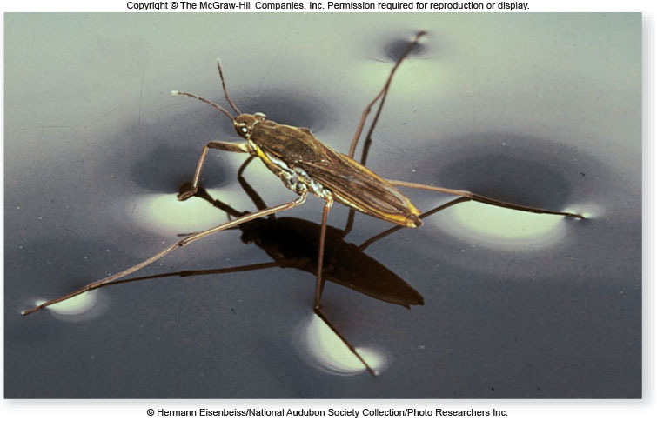
The Atoms, Elements and Molecules
Chapter 6

Slide 3
Atomic Structure
All matter is composed of atoms.
Atoms are the building blocks of matter.

Slide 4
Atomic Structure
Atoms are composed of
-protons – positively charged particles
-neutrons – neutral particles
-electrons – negatively charged particles
Protons and neutrons are located in the nucleus. Electrons are found in orbitals surrounding the nucleus.

Slide 5
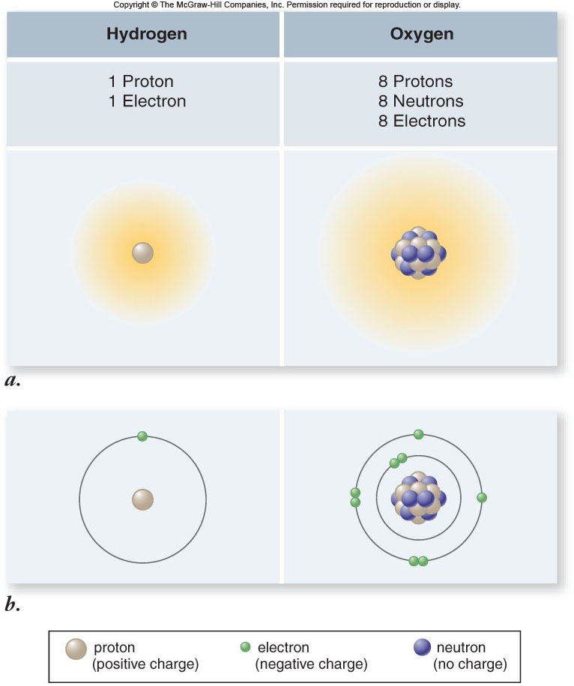
Atomic Structure

Slide 6
Atomic Structure
Every different atom has a characteristic number of protons in the nucleus.
atomic number = number of protons
Valence electrons are the electrons in the outermost energy level of an atom.
These electrons are what allow atoms to join to make molecules and compounds.

Slide 7
Atomic Structure
Each proton and neutron has a mass of approximately 1 dalton.
The sum of protons and neutrons is the atom’s atomic mass.
Isotopes – atoms of the same element that have different atomic mass numbers due to different numbers of neutrons.

Slide 8
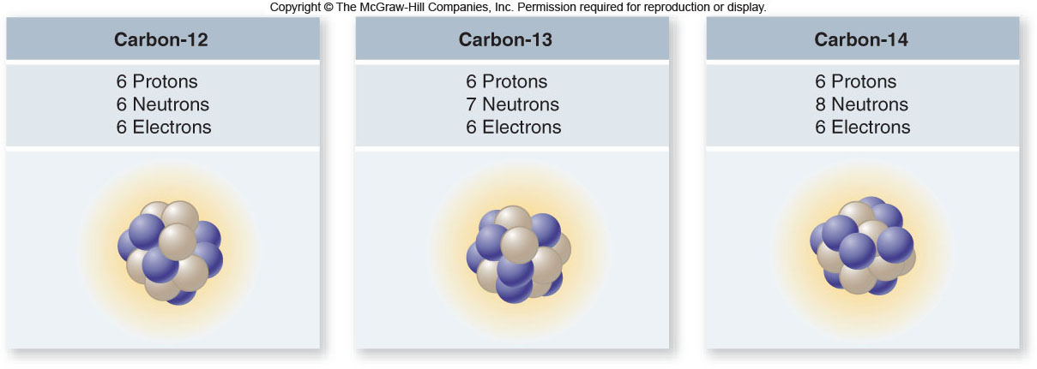
Atomic Structure

Slide 9
Elements
Atoms with the same atomic number have the same chemical properties and belong to the same element.
Elements are made up of the same type of atoms.
An element’s chemical properties depend on interactions between valence electrons of different atoms.

Slide 10
Elements
The Periodic Table arranges all elements according to their atomic number.
The table identifies elements with similar chemical properties.
There are 92 Naturally occurring Elements.

Slide 11
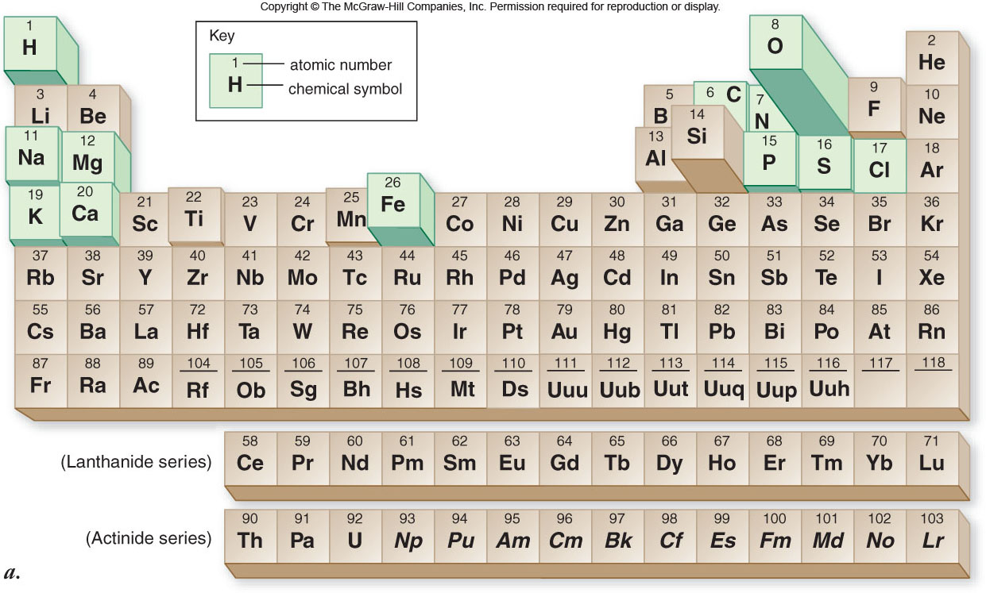
Periodic Table of the Elements

Slide 12
Elements
Of the 92 naturally occurring elements.
Only 12 elements are found in living organisms in substantial amounts.
Four elements make up 96.3% of human body weight:
- carbon, hydrogen, oxygen, nitrogen

Slide 13
Chemical Bonds
Molecules are groups of atoms held together in a stable association.
Compounds are molecules containing more than one type of element.
Atoms are held together in molecules or compounds by chemical bonds.

Slide 14
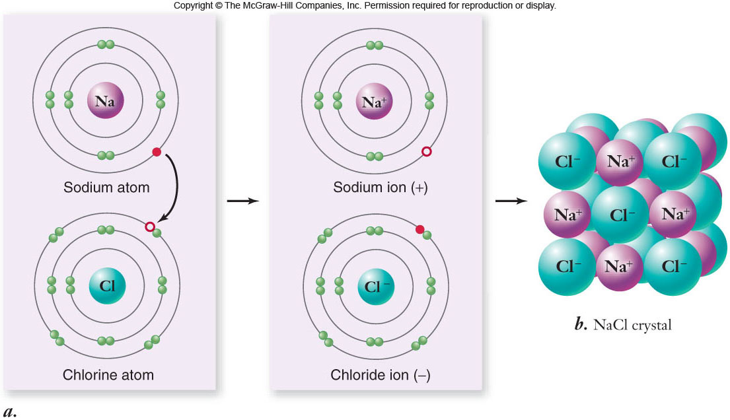
Chemical Bonds
Ionic bonds are formed by the attraction of oppositely charged ions.

Slide 15
Chemical Bonds
Covalent bonds form when atoms share 2 or more valence electrons.
Covalent bond strength depends on the number of electron pairs shared by the atoms.
single
bond
<
double
bond
<
triple
bond

Slide 16
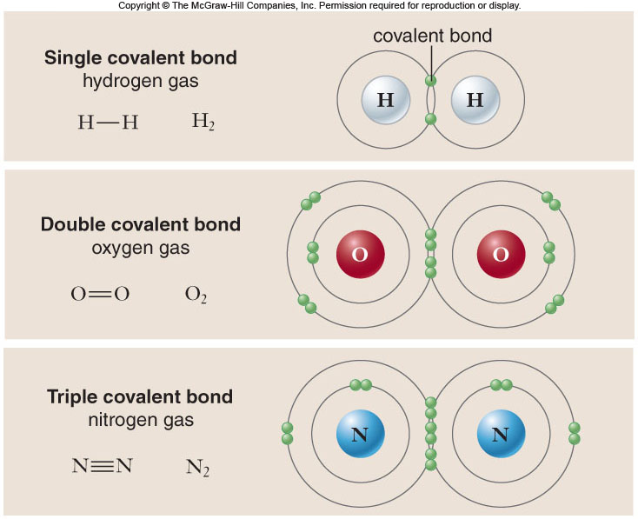
Chemical Bonds

Slide 17
Chemical Bonds
Electronegativity is an atom’s affinity for electrons.
Van der Waals Forces
Differences in electronegativity dictate how electrons are distributed in covalent bonds.
- nonpolar covalent bonds = equal sharing of electrons
- polar covalent bonds = unequal sharing of electrons

Slide 18
Chemical Bonds Ch 6.2
Chemical reactions involve the formation or breaking of chemical bonds.
Whether a chemical reaction occurs is influenced by
-temperature
-concentration of reactants and products
-availability of a catalyst (see energy reactions)

Slide 19
Chemical Bonds
Chemical reactions are written with the reactants first, followed by the products.
6H₂O + 6CO₂ C₆H₁₂O₆ + 6O₂
reactants products
Chemical reactions are often reversible.
C₆H₁₂O₆ + 6O₂ 6H₂O + 6CO₂

Slide 20
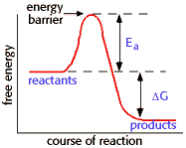
Energy Of Reactions
Activation Energy: The minimum amount of energy needed to start a reaction.

Slide 21
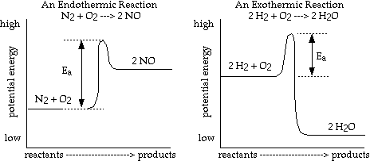
Energy of Reactions

Slide 22
Energy of Reactions
Catalyst is a substance that lowers the activation energy needed to run a reaction.
Catalysts speed up the reaction, sometimes by a thousand times, but do not change the outcome of the reaction and do not become part of the reaction.
The Catalyst is not used up It may be reused.
The amount of product stays the same.
The amount of reactant stays the same.

Slide 23
Energy of Reactions
Enzymes: Special Proteins that function as Biological catalysts.
Most enzymes are specific to one reaction.
Amylase and digestion. Found in saliva.
Helps breakdown the digestion of amylose a component of starch.

Slide 24
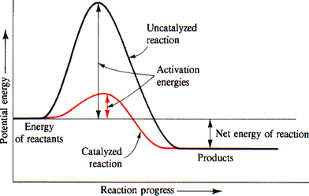

Slide 25
Water Chemistry
All living organisms are dependent on water.
The structure of water is the basis for its unique properties.
The most important property of water is the ability to form hydrogen bonds.

Slide 26
Water Chemistry
Within a water molecule, the bonds between oxygen and hydrogen are highly polar.
Partial electrical charges develop:
- oxygen is partially negative
- hydrogen is partially positive

Slide 27
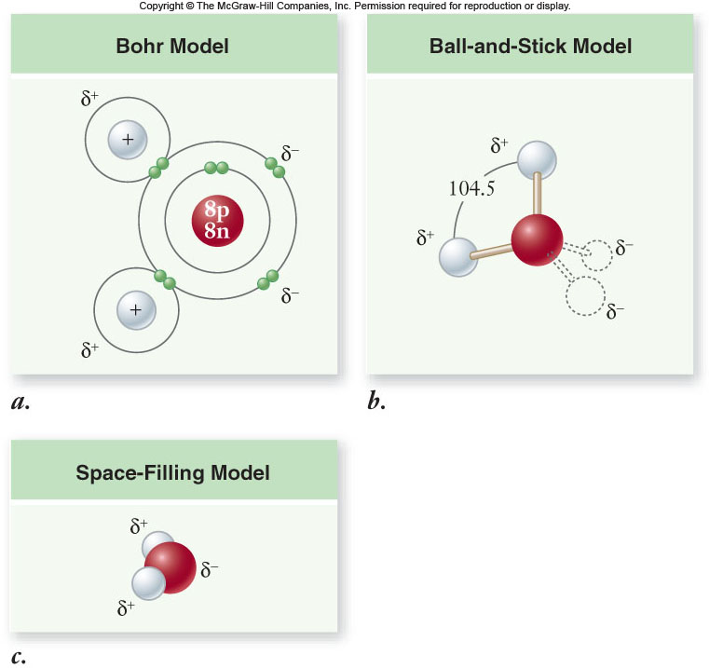
Water Chemistry

Slide 28
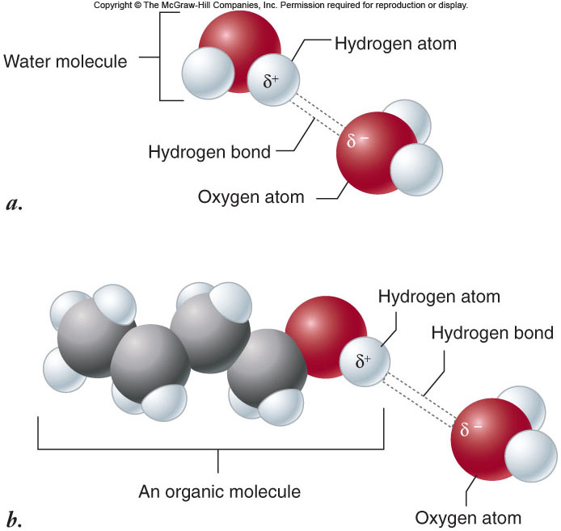
Water Chemistry

Slide 29
Properties of Water
1. Solid water is less dense than liquid water.
- Bodies of water freeze from the top down.
2. Water is a good solvent.
- Water dissolves polar molecules and ions.

Slide 30
Properties of Water
3. Water organizes nonpolar molecules.
- hydrophilic: “water-loving”
-hydrophobic: “water-fearing”
- Water causes hydrophobic molecules to aggregate or assume specific shapes.
4. Water can form ions.
H₂O → OH⁻¹ + H⁺¹
hydroxide ion hydrogen ion

Slide 31
Acids and Bases
Hydrogen ion (H⁺¹) is the basis of the pH scale.
Greater H⁺¹ concentration --- lower pH (acidic)
Lower H⁺¹ concentration --- higher pH (basic)

Slide 32
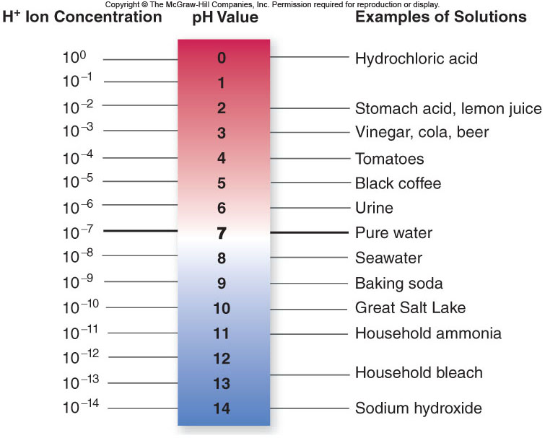
Acids and Bases

Slide 33
Acids and Bases
Acid: a chemical that releases H⁺¹ ions.
Base: a chemical that accepts H⁺¹ ions.
Buffer: a chemical that accepts/releases H⁺¹ as necessary to keep pH constant

Slide 34
Carbohydrates
Molecules with a 1:2:1 ratio of carbon, hydrogen, oxygen
-empirical formula: (CH₂O)_{n}
-examples: sugars, starch, glucose
C – H covalent bonds hold much energy
Carbohydrates are good energy storage molecules.

Slide 35
Carbohydrates
Glucose
-a monosaccharide – single sugar
-contains 6 carbons
-very important in energy storage
-fructose is a structural isomer of glucose
-galactose is a stereoisomer of glucose

Slide 36
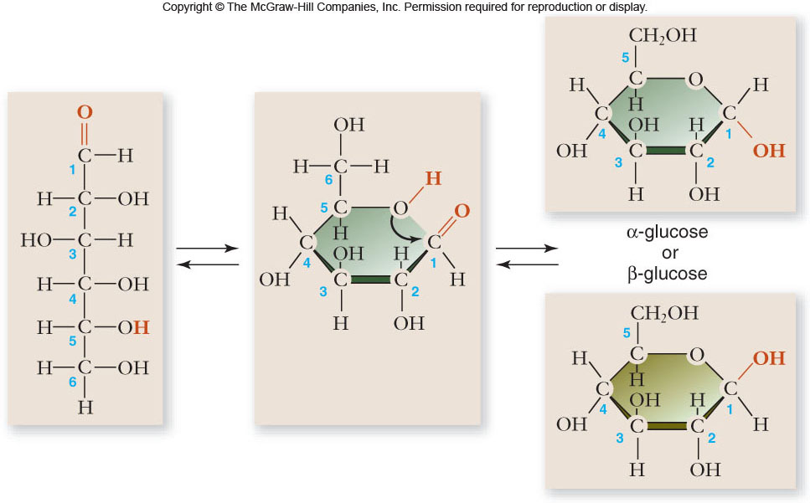
Carbohydrates

Slide 37
Carbohydrates
Disaccharides
-2 monosaccharides linked together by dehydration synthesis
-used for sugar transport or energy storage
-examples: sucrose, lactose, maltose

Slide 38
Carbohydrates
Polysaccharides
-long chains of sugars
-used for energy storage
-plants use starch; animals use glycogen
-used for structural support
-plants use cellulose; animals use chitin

Slide 39
Lipids
Lipids are a group of molecules that are insoluble in water.
A high proportion of nonpolar C – H bonds causes the molecule to be hydrophobic.
Two main categories:
-fats (triglycerides)
-phospholipids

Slide 40
Lipids
Triglycerides (fats)
-composed of 1 glycerol + 3 fatty acids
Fatty acids are long hydrocarbon chains which may be
-saturated
-unsaturated
-polyunsaturated

Slide 41
Lipids
Triglycerides
-an excellent molecule for energy storage
-store twice as much energy as carbohydrates
-animal fats are usually saturated fats and are solid at room temperature
-plant fats (oils) are usually unsaturated and are liquid at room temperature

Slide 42
Lipids
Phospholipids -composed of:
-1 glycerol
-2 fatty acids
-a phosphate group
Phospholipids contain polar “heads” and nonpolar “tails”.

Slide 43
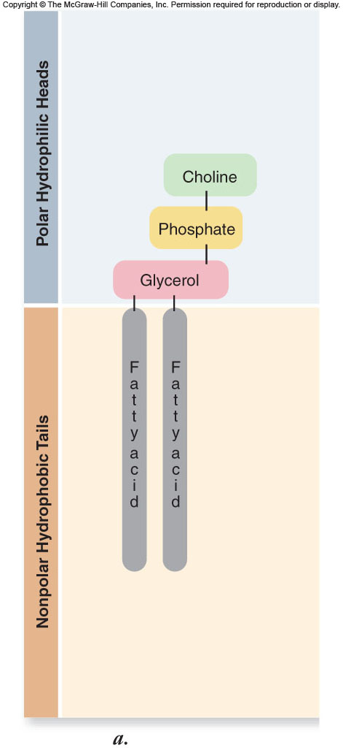
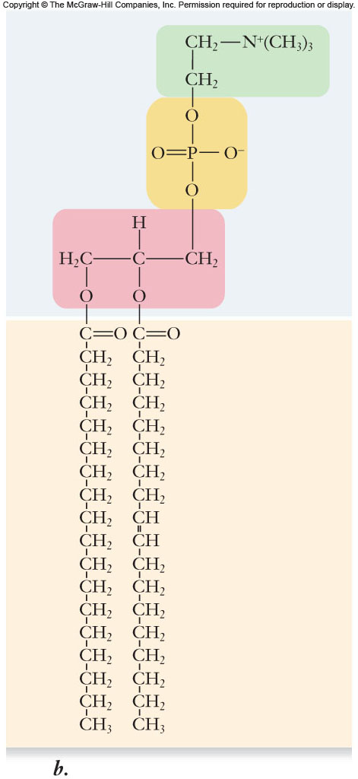
Lipids

Slide 44
Lipids
Phospholipids spontaneously form micelles or lipid bilayers.
These structures cluster the hydrophobic regions of the phospholipid toward the inside and leave the hydrophilic regions exposed to the water environment.
Lipid bilayers are the basis of biological membranes.

Slide 45
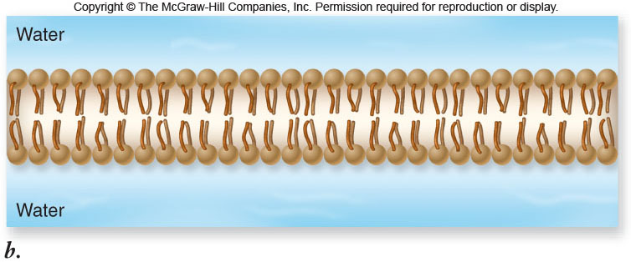
Lipids

Slide 46
Proteins
Proteins are polymers of amino acids.
Amino acids
-20 different amino acids
-joined by dehydration synthesis
-peptide bonds form between adjacent amino acids

Slide 47
Proteins
Protein functions include:
1. enzyme catalysts
2. defense
3. transport
4. support
5. motion
6. regulation
7. storage

Slide 48
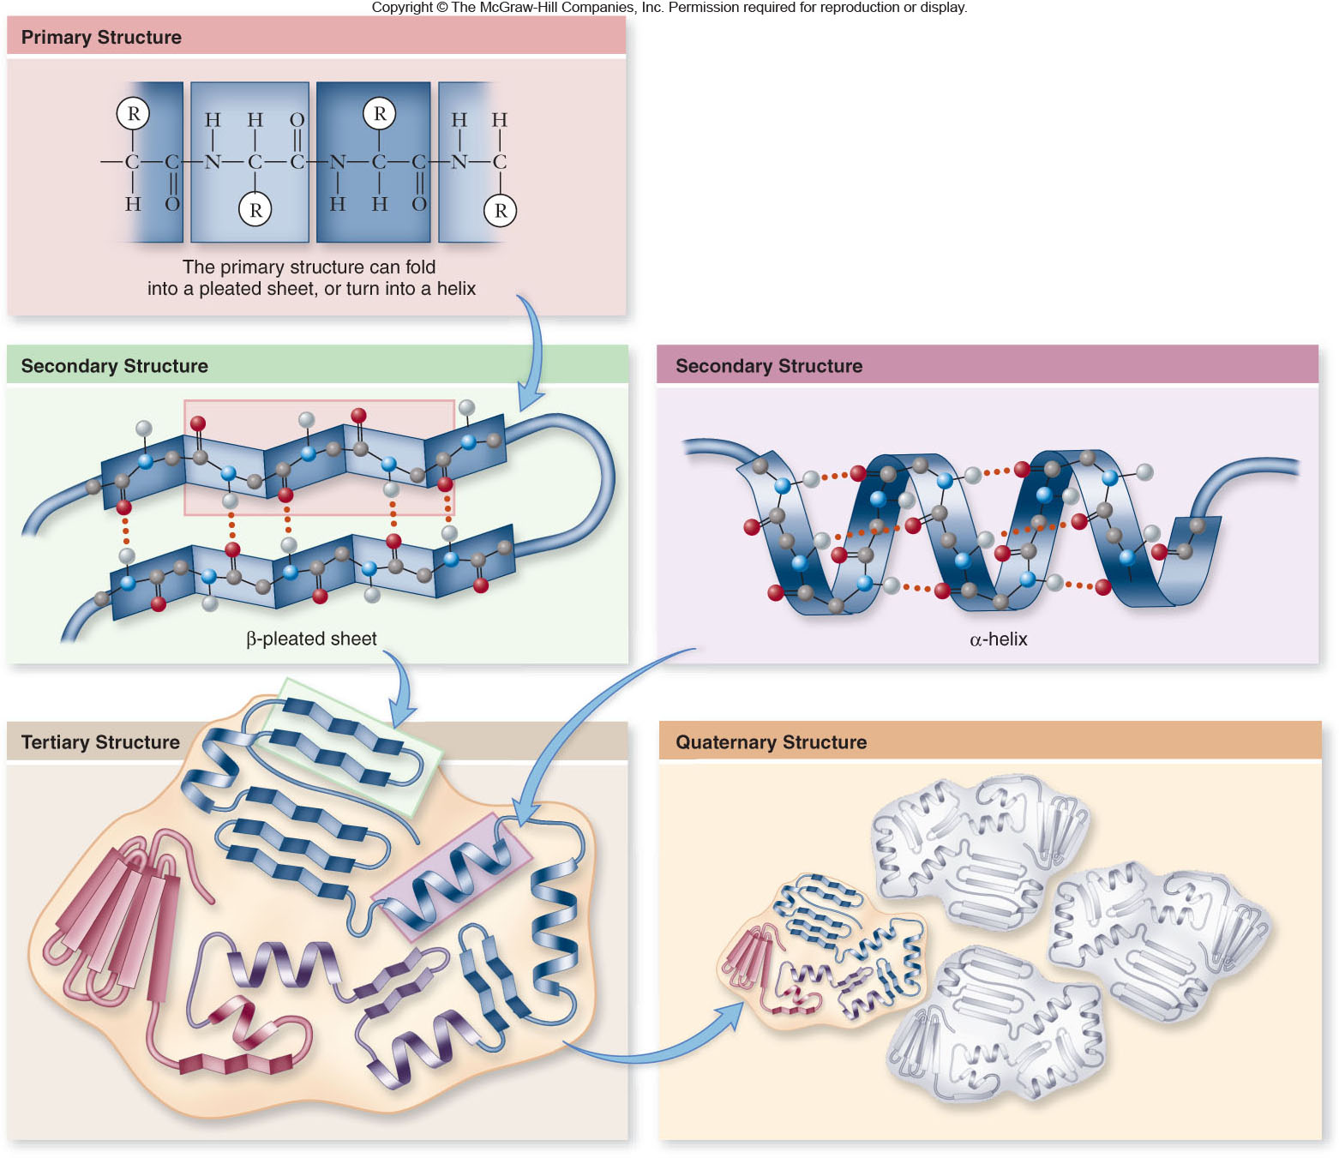
Proteins

Slide 49
Nucleic Acids
Two types: DNA and RNA
Functions: specialized for the storage, transmission, and use of genetic information

Slide 50
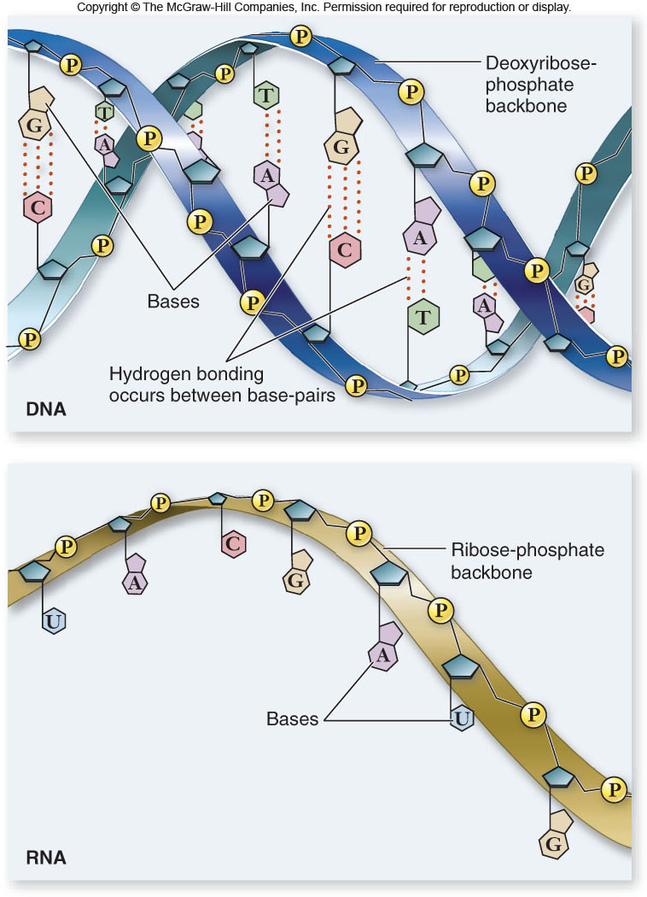
Nucleic Acids

Slide 51
Nucleic Acids
Nucleic acids are polymers of nucleotides.
-nucleotides:
sugar + phosphate + nitrogenous base
-sugar is deoxyribose in DNA
or ribose in RNA
-Nitrogenous bases include
-purines: adenine and guanine
-pyrimidines: thymine, cytosine, uracil

Slide 52
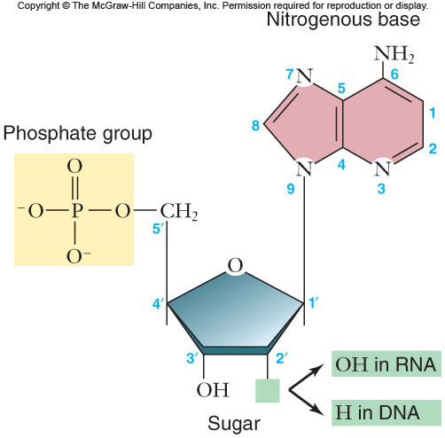
Nucleic Acids

Slide 53
Nucleic Acids
Other nucleotides
-ATP: adenosine triphosphate
-primary energy currency of the cell

